Slide 1
Object Recognition
Emina Dzaferovic

Slide 2
Dependencies
Flask => used to build web application
TensorFlow => used to provide object recognition

Slide 3
TensorFlow
Open-source framework developed by Google
Tool used for machine learning, primarily designed for deep neural network models
Provide different models to help with different problems
“classify_image.py” => built in model used in my application

Slide 4
Flask
Python library used to setup the web application
Used to read files (images) which are to be processed by Tensorflow

Slide 5
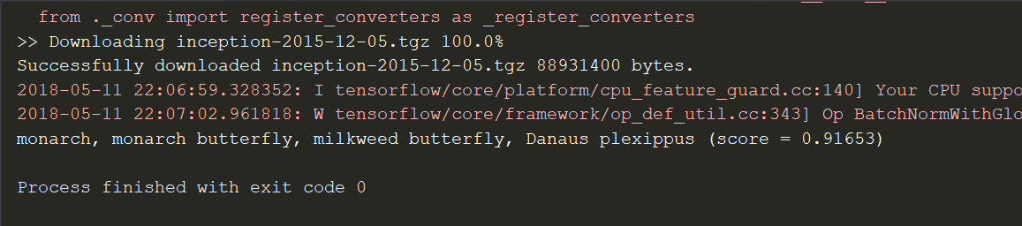
“classify_image.py”

Slide 6
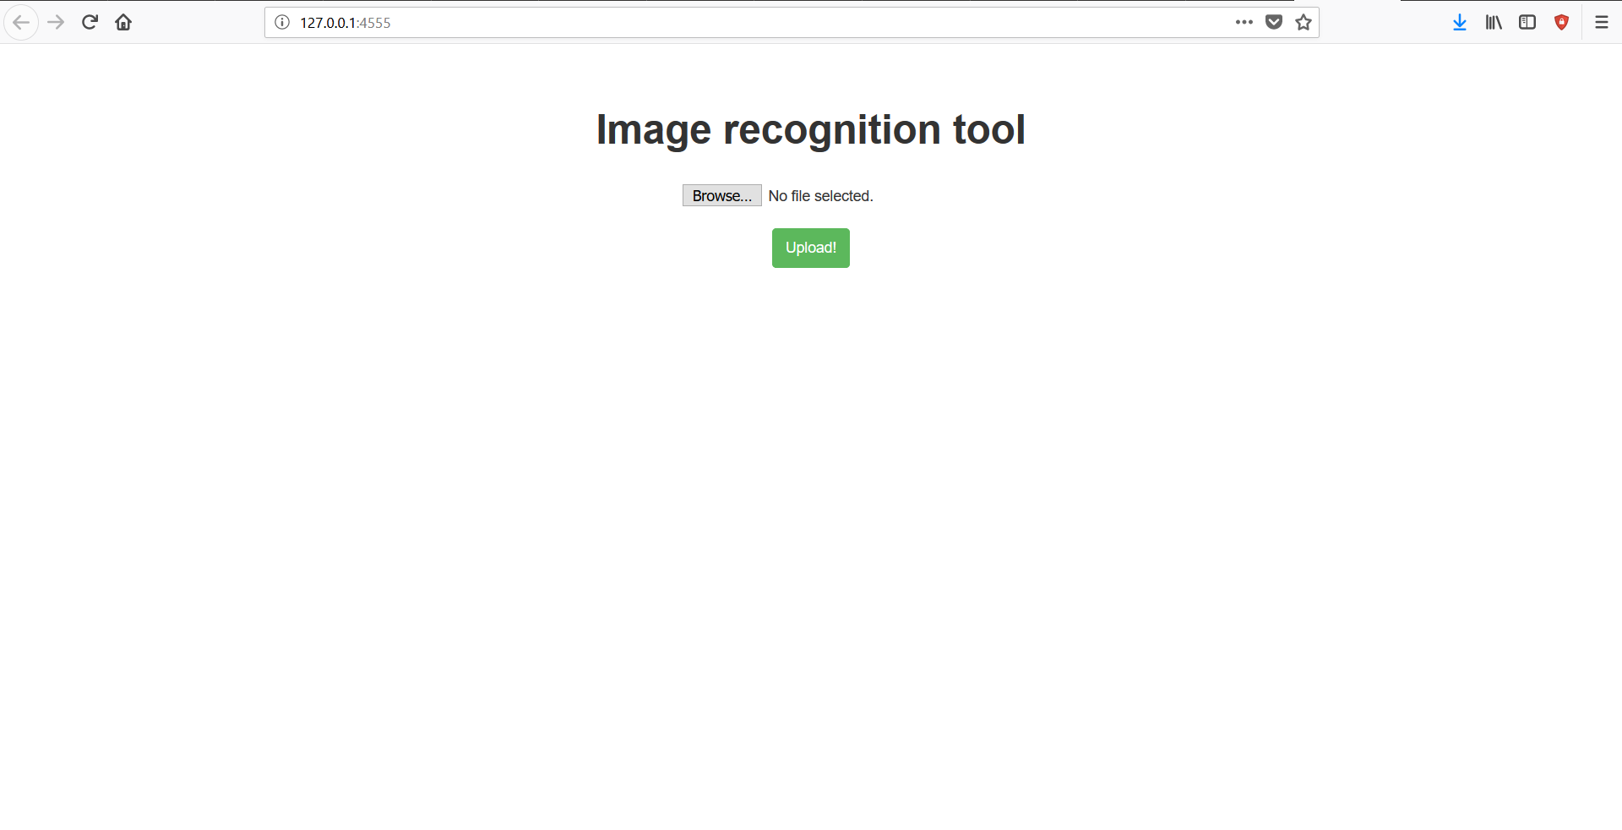
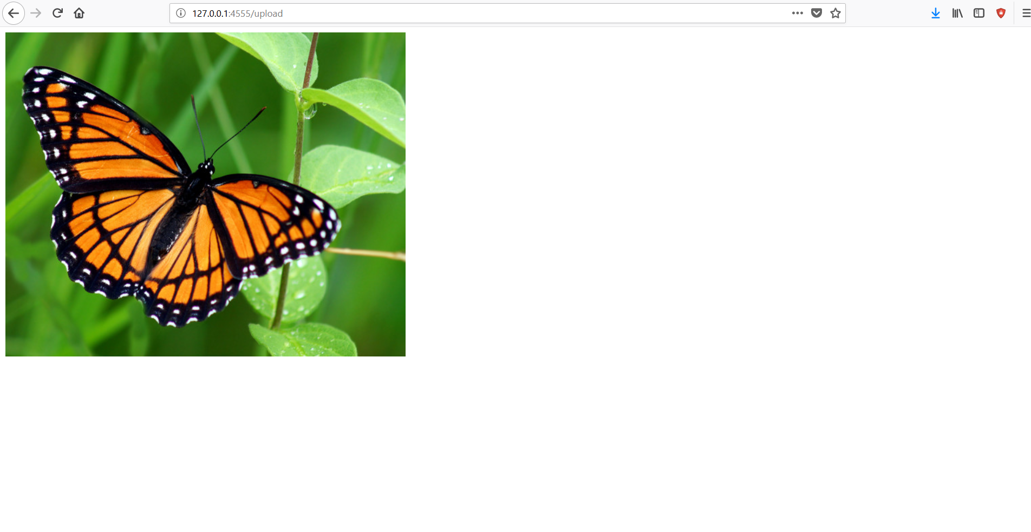
Flask

